Slide 1
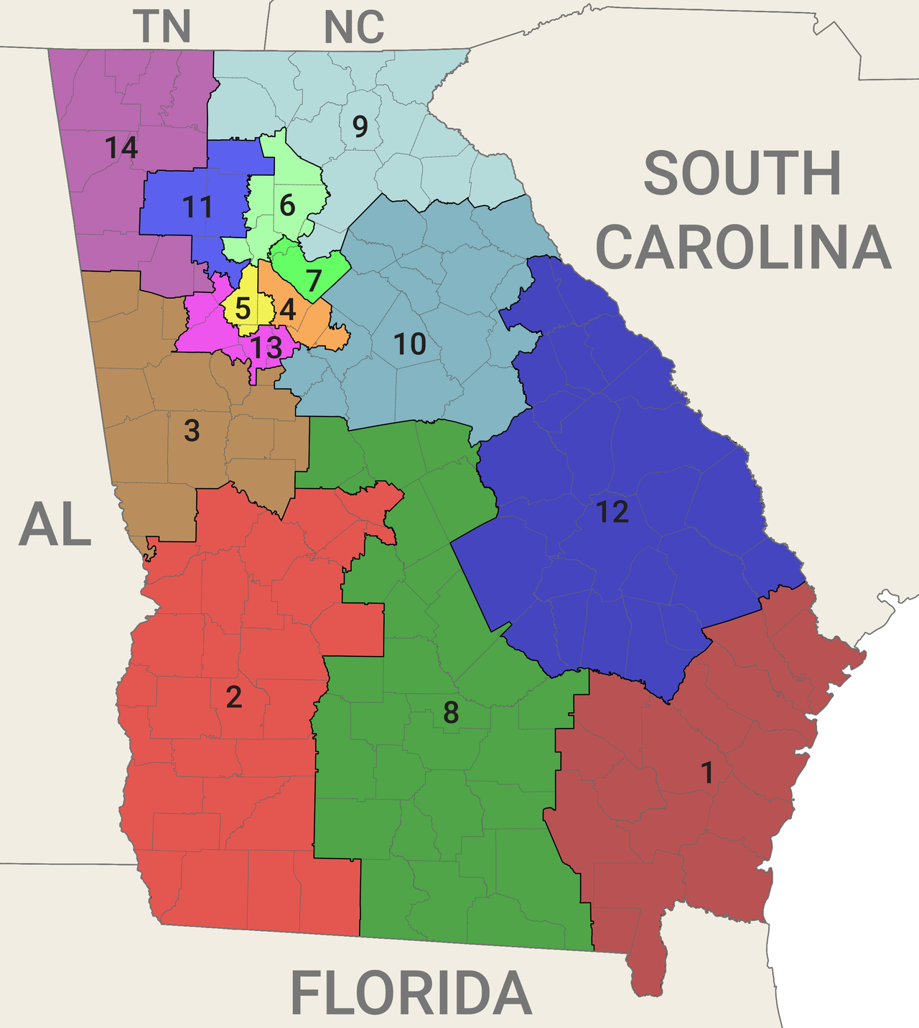
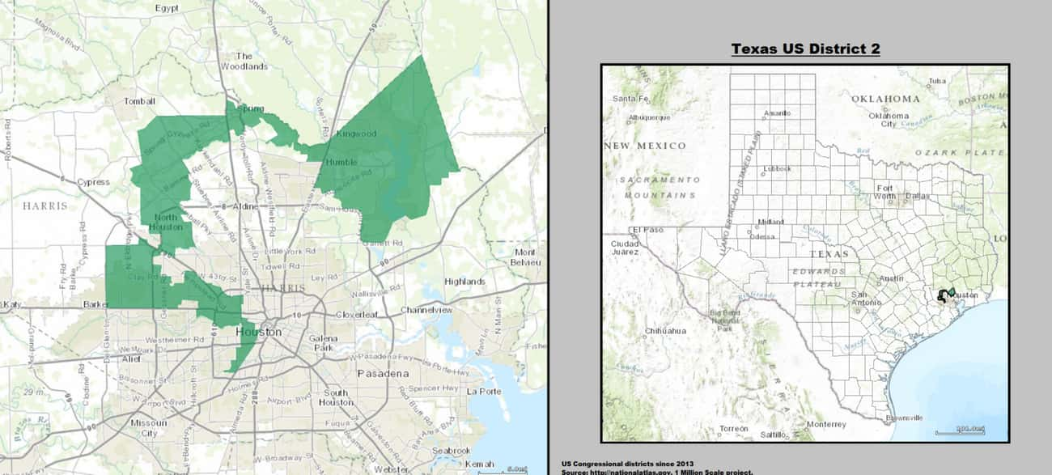
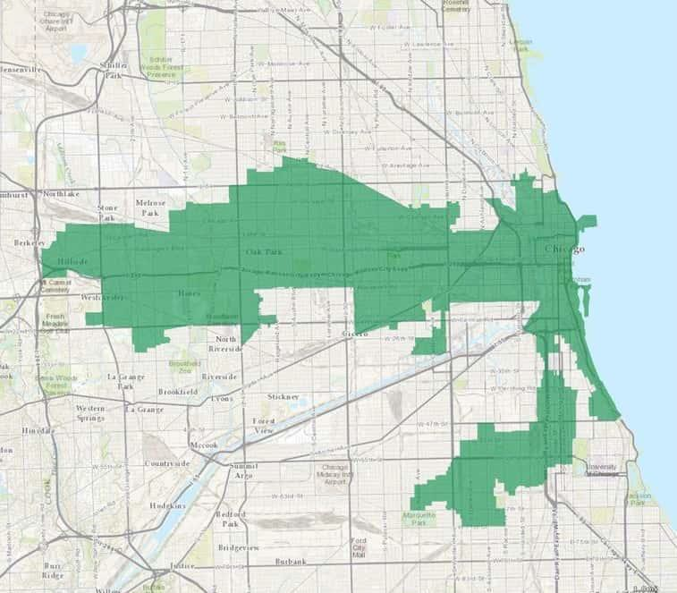
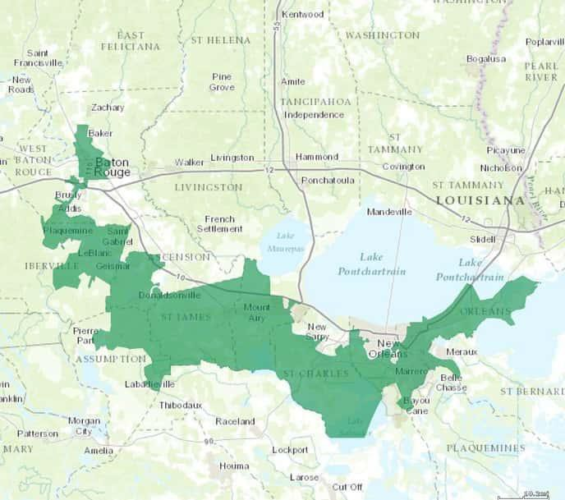
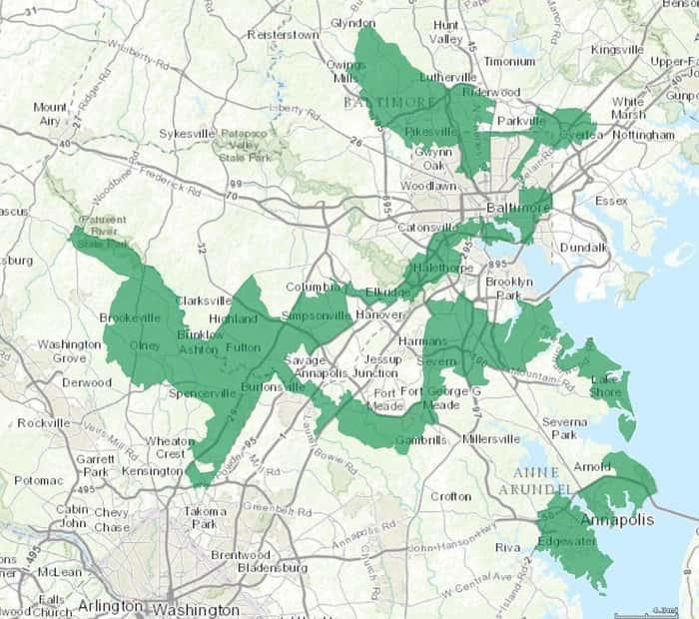
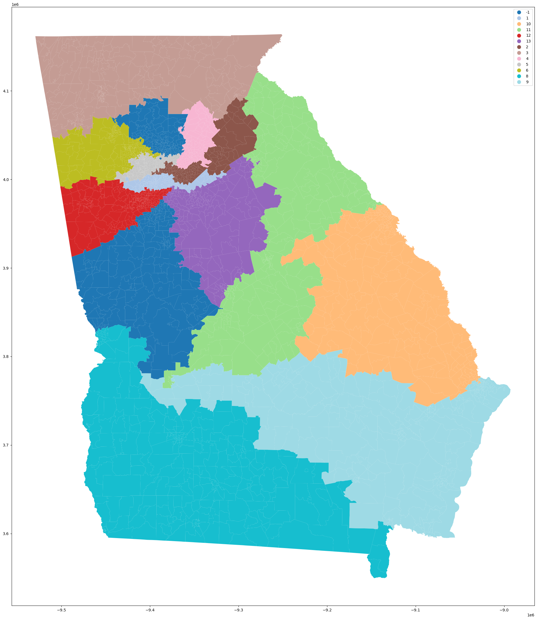
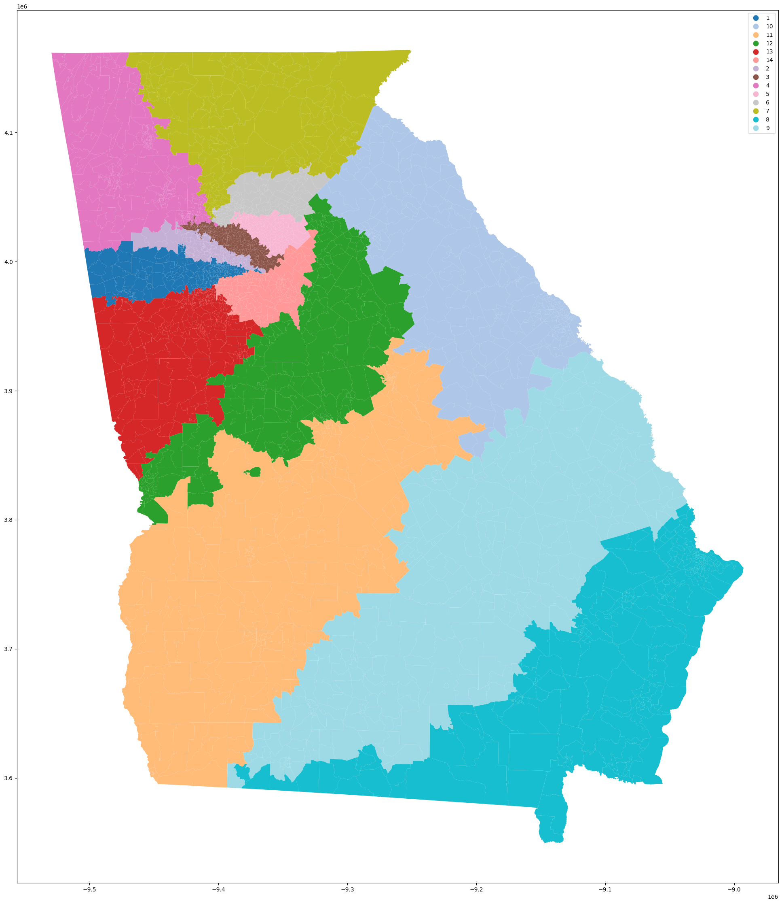
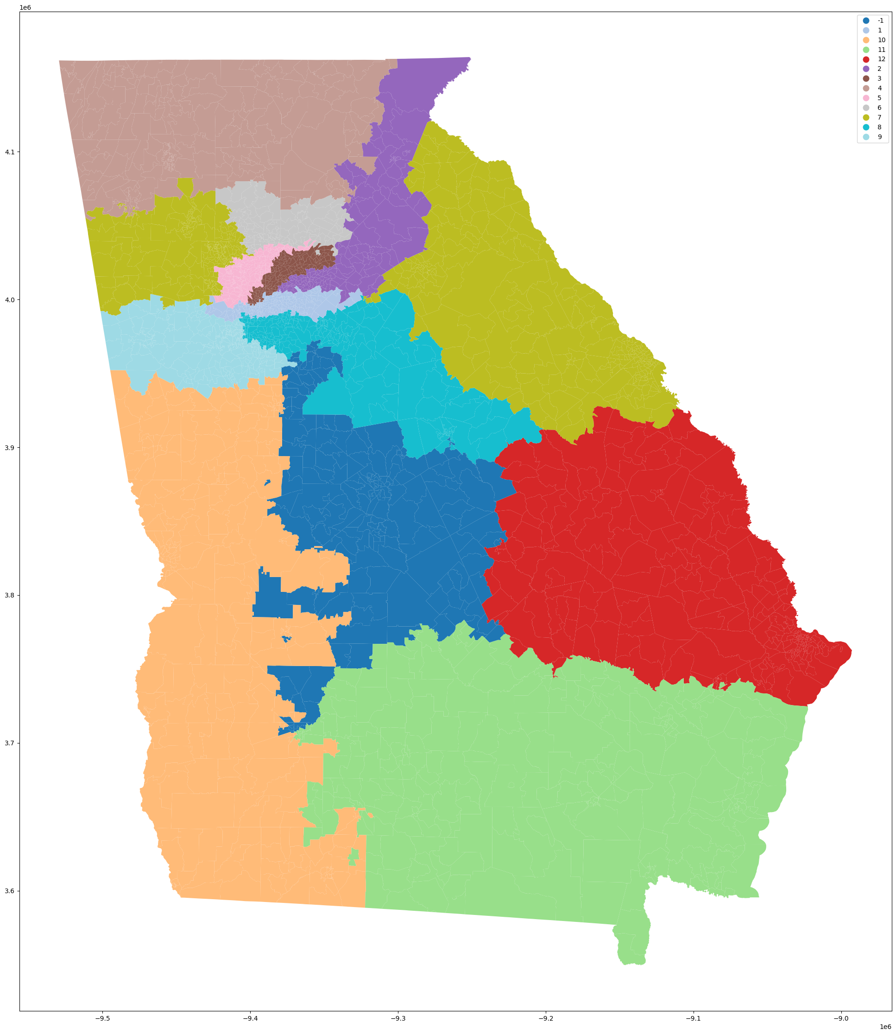
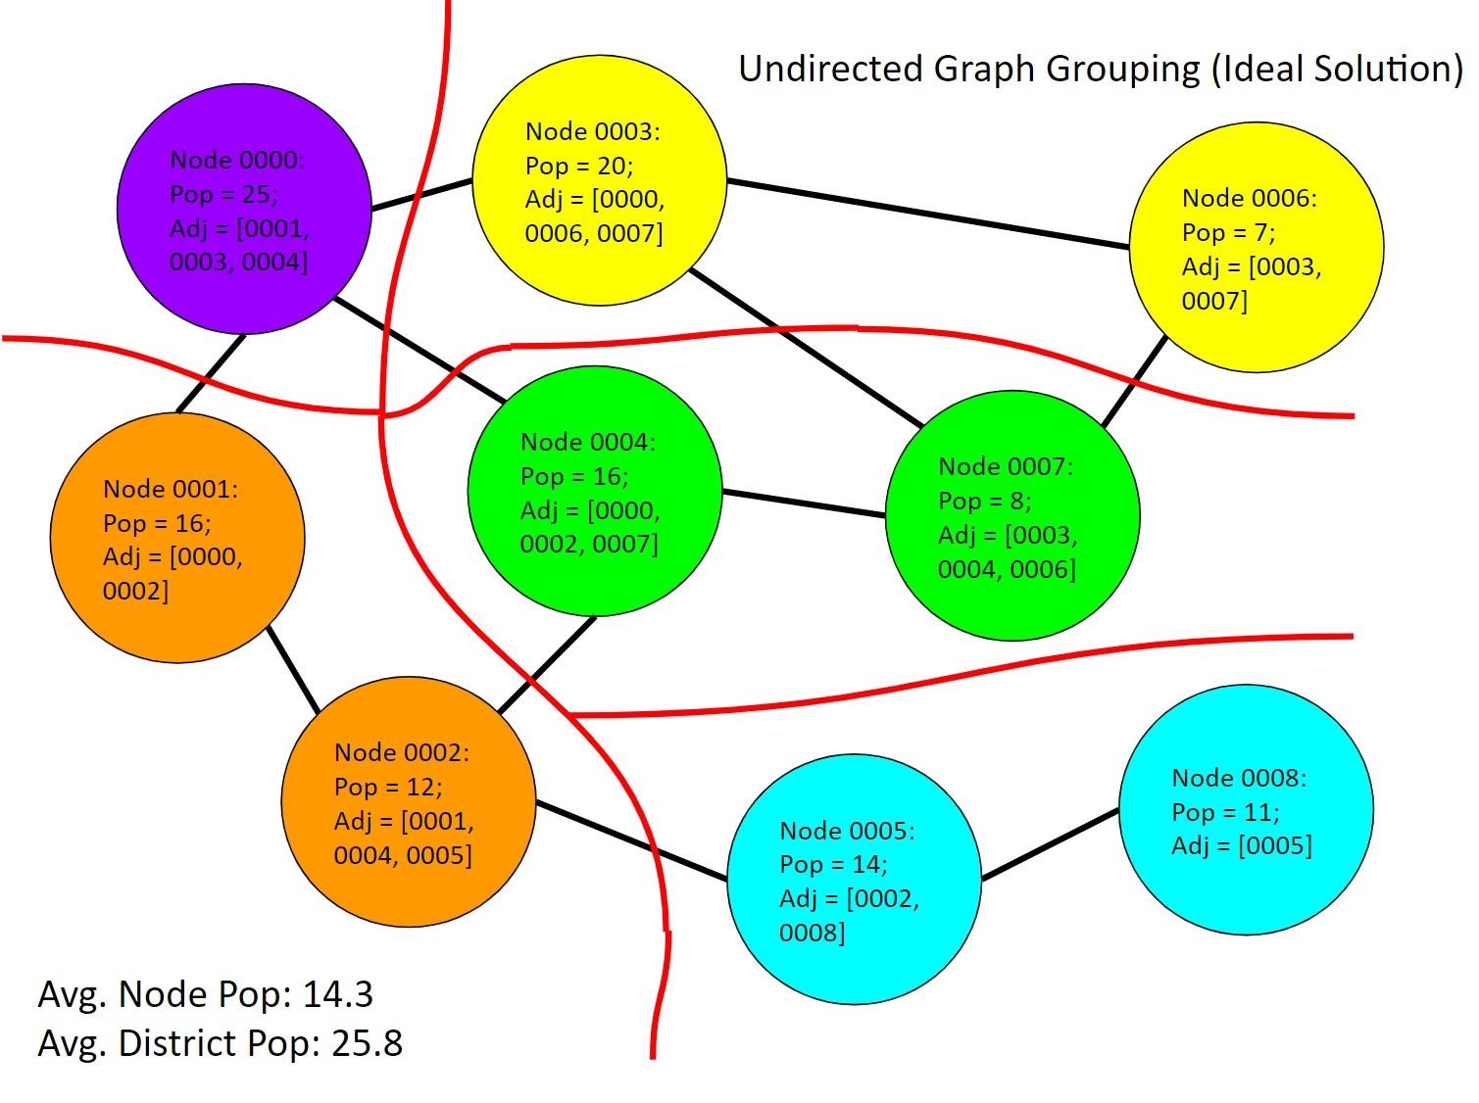

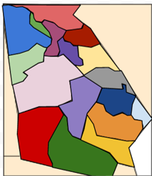
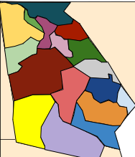
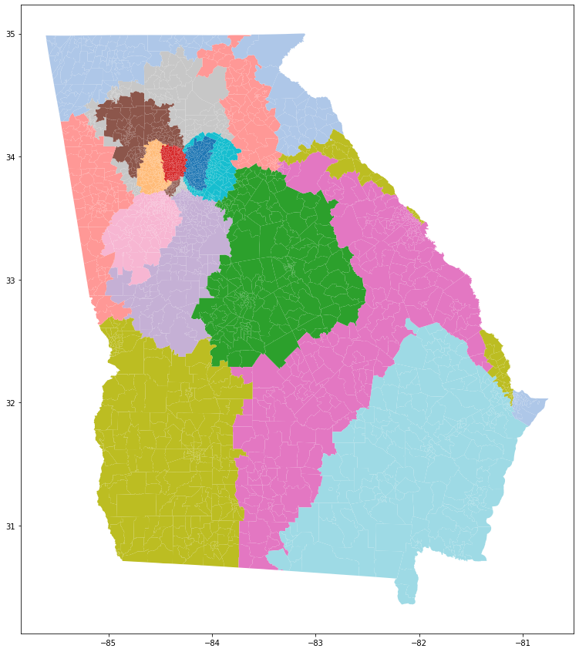
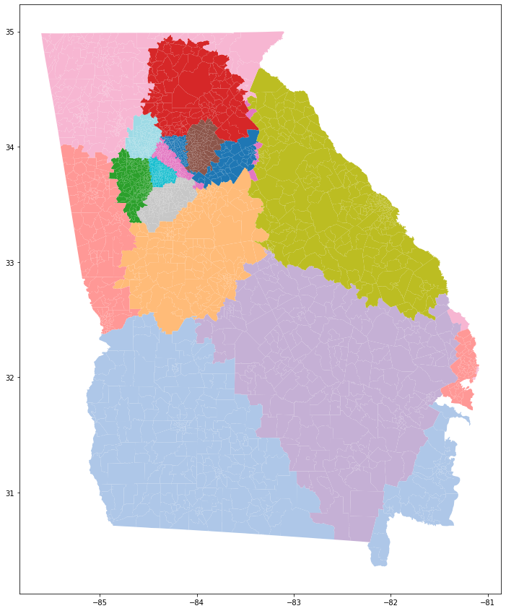
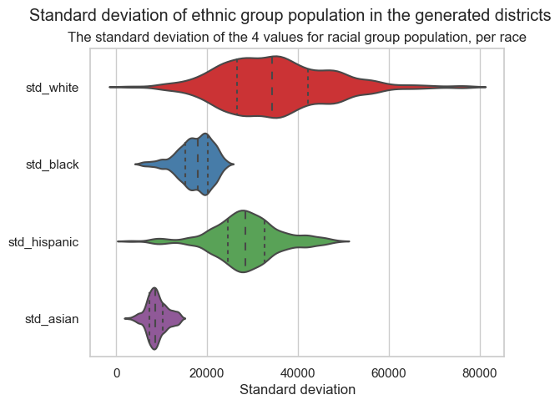
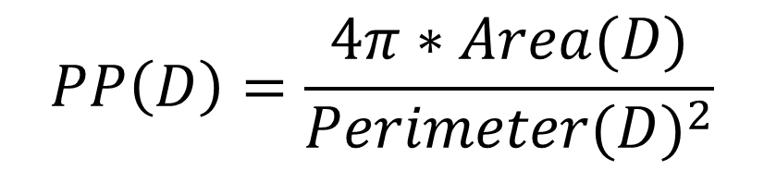
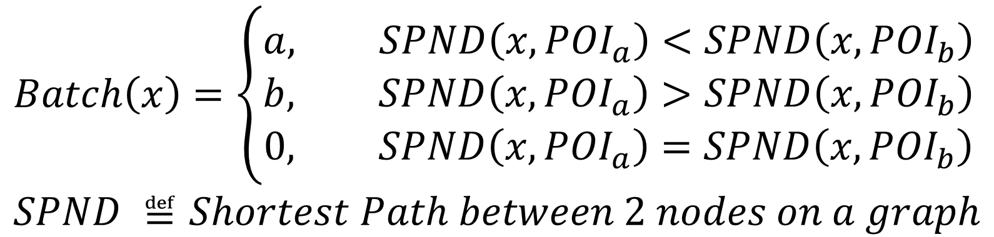
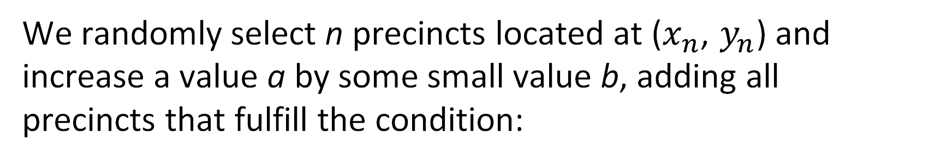
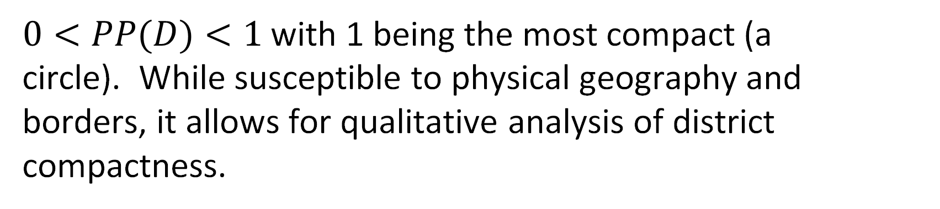
Using Mathematical Modeling to create Non-Gerrymandered Congressional Voting Maps
FWRSEF Scienteer Project #220351
BACKGROUND
STATE OF CHOICE
METRICS
DISCUSSION
Gerrymandering is one of the biggest problems in American democracy.
We chose to use Georgia to compare our algorithms, for the following reasons.
Georgia has a large racial diversity
Georgia is contiguous.
Georgia has existing gerrymandering.
Georgia is a highly competitive political state.
One existing measure of Compactness in relation to gerrymandering is the Polsby-Popper test.
Ideal Partition | Circular Engulfment | Least Required Pop. Grouping
Accurate, continuous, and compact Splits and groups urban areas Large run time with infinite loops possible | Compact and adjacent districts Works well with urban areas Medium run time, always resolves | Geographically inconsistent Repeatable solution, low variance Shortest runtime
$$PP\left(D\right)=\frac{4π∗Area(D)}{{Perimeter(D)}^{2}}$$
$0<PP(D)<1$with 1 being the most compact (a circle). While susceptible to physical geography and borders, it allows for qualitative analysis of district compactness.
Texas D2 – (2013 – 2023)
Louisiana D2 – (2013+)
Maryland D3 – (2013 – 2023)
[4]
[5]
Political parties have used redistricting as a method of maintaining political control. Often, they create safe districts and expand their reach far beyond the will of the voters.
A mathematical solution to political gerrymandering could help create a more vibrant and fair democracy. Without any settled solution to political gerrymandering, our democracy continues to be unrepresentative.
GENERATIONAL METHODS
We propose three distinct algorithms to create non-gerrymandered voting maps.
IDEAL PARTITION
We pick 2 random precincts separated by at least a given parameter d edges when traversing the shortest path between those districts, and then we assign every precinct in the map to a batch depending on which of the two random precincts it is closer to (leaving equidistant precincts unassigned).
If the population within the smaller of the two batches can form a district when some unassigned areas is added, we gradually add adjacent areas from the unassigned batch until we reach our optimal population.
After n-1 iterations of steps I through II, we will have n-1 districts, and all remaining area forms one last district
This algorithm can be iterated, first breaking the state into sub-states, and then into final districts.
FUTURE WORK
Our future work for this project:
Applying algorithms to all US states and determining if results hold true for the rest of the United States
Simulate a nationwide election and compare the composition of the theoretical elected Congress to the current one
Address edge case adjacency for islands (Galveston, Long Island, Hawaii) and irregularly states (Florida or Maryland)
Iterative Ideal Partition has some caveats with its population density-based iteration so it may be faster to split states into small groups and then conducting partitions
LEAST REQ. POP. GROUPING (LRPG)
Zip codes are used as nodes in an undirected graph.
An origin node is chosen randomly and becomes node at index 0 in the adjacency list.
Every other node is ordered based on geographic distance from N_0
We iterate through every node, by adding the node to a district, and tracking the total population.
This iteration continues until the minimum population is exceeded
Steps II through IV are repeated until we reach the end of the list of nodes.
Variance b/w runs: ~5%; Average run time: 3 sec
$$Batch\left(x\right)=\left\{\begin{aligned}a, SPND\left(x, {POI}_{a}\right)<SPND\left(x, {POI}_{b}\right) \\ &b, SPND\left(x, {POI}_{a}\right)>SPND\left(x, {POI}_{b}\right) \\ 0, SPND\left(x, {POI}_{a}\right)=SPND\left(x, {POI}_{b}\right)\end{aligned}\right. \\ SPND ≝Shortest Path between 2 nodes on a graph$$
We used undirected graph representations of precincts for the Ideal Partition and LRPG models, as the geographic shape of the state is irrelevant to their performance. Only the precinct data and the adjacency is maintained. We define adjacency as 2 precincts must share a finite edge to be considered neighbors. In other words, point or corner adjacency is not 'rook' adjacent.
CIRCULAR ENGULFMENT
REFERENCES
We randomly select n precincts located at ($x_{n}$, $y_{n}$) and increase a value a by some small value b, adding all precincts that fulfill the condition:
Gupta, S., Jain, P., Panolan, F., Roy, S., & Saurabh, S. (2021). Gerrymandering on graphs: Computational complexity and parameterized algorithms. In International Symposium on Algorithmic Game Theory, 140-155. Springer, Cham.
MGGG Redistricting Lab. (n.d.). Districtr [Website]. Retrieved from https://districtr.org/
Redistricting Data Hub. (2021, December 1). Election Results and Precinct Boundaries [Website]. Retrieved from https://redistrictingdatahub.org/data/about-our-data/election-results-and-precinct-boundaries/
US Census Bureau. (2022, September 27). US Zip Codes Database [Website]. Retrieved from https://simplemaps.com/data/us-zips
Civil Rights in America: Racial Voting Rights [Website]. (2009). U.S. National Park Service, U.S. Department of the Interior. Retrieved 23 January 2023.
Polsby, D. D., & Popper, R. D. (1991). The Third Criterion: Compactness as a procedural safeguard against partisan gerrymandering. Yale Law & Policy Review, 9(2), 301-353.
Ansolabehere, S., & Palmer, M. (n.d.). A Two Hundred-Year Statistical History of the Gerrymander, pp. 6-7.
OBJECTIVES
$$\sqrt{{(x−x_{n})}^{2}+{(y−y_{n})}^{2}} ≤a$$
Create representative districts using geographical data and iterative mathematical techniques
Determine whether existing districts are gerrymandered based on various demographic trends
The value a is increased until all precincts are assigned to a district. Districts above a population threshold no longer have precincts added to their total.
STATISICAL ANALYSIS
We aim to create a future in which representatives embody the constituents of a state. When representatives fail to accurately relay their constituents’ beliefs, the core tenet of representative democracy is shattered. By addressing the problem of gerrymandering mathematically, rather than by a subjective method, we can potentially create a system that returns power to citizens rather than state legislatures.
Statistical robustness has proved near impossible, as these methods may not preserve randomness To address this, we have chosen to simply calculate p-values using the an integral on a density graph.
Variance b/w runs: ~25% Average run time: 60 sec

Slide 2



Abstract
Form 1C

